Slide 3


THE STATE OF THE DEVELOPER ECOSYSTEM
Carlos Mendible
Technical Manager @everis
@cmendibl3

Slide 4















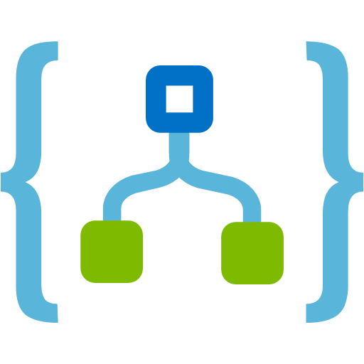



























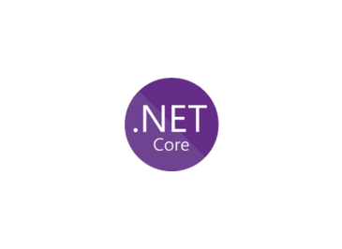


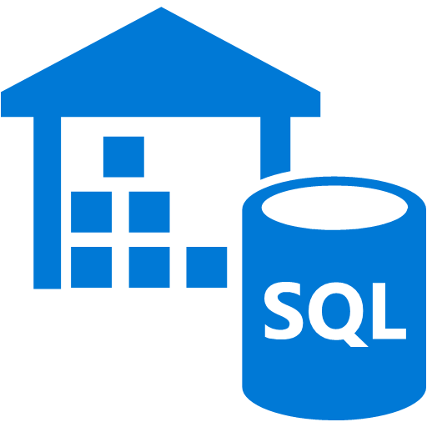





















































Slide 5
Which languages do employers look for worldwide?
HackerRank 2018 Developer Skills Report
Notes:
What are employees looking for worldwide?
According to hacker rank that JavaScript is the leader, followed by Java and Python and C# is in 6th place
https://research.hackerrank.com/developer-skills/2018/

Slide 6
Number of Pull Requests.
Octoverse 2017
Notes:
What does github and OSS world have to say about that?
We can se the same pattern here with javascript also winning the battle and a tie between Java and Python
C# is in the 8th place

Slide 7
Public Cloud Adoption
RightScale 2018 Scale of the Cloud Report
Notes:
% Of Respondants Running Applications
1000 respondants

Slide 8
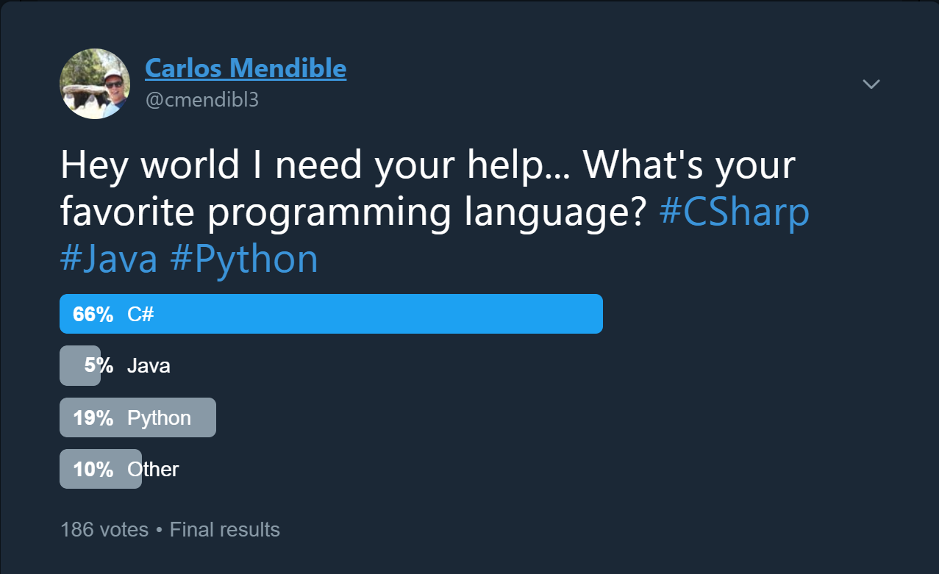
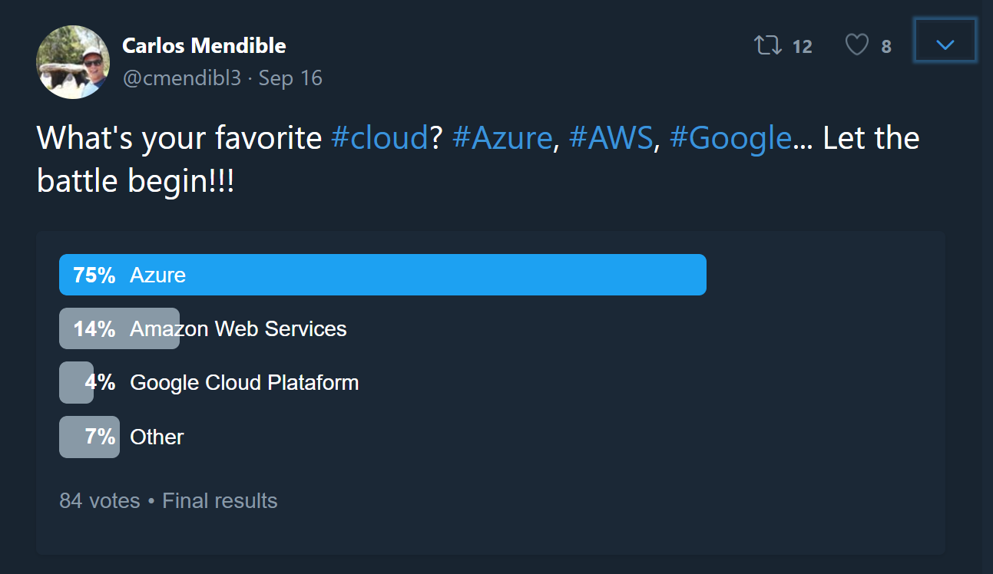
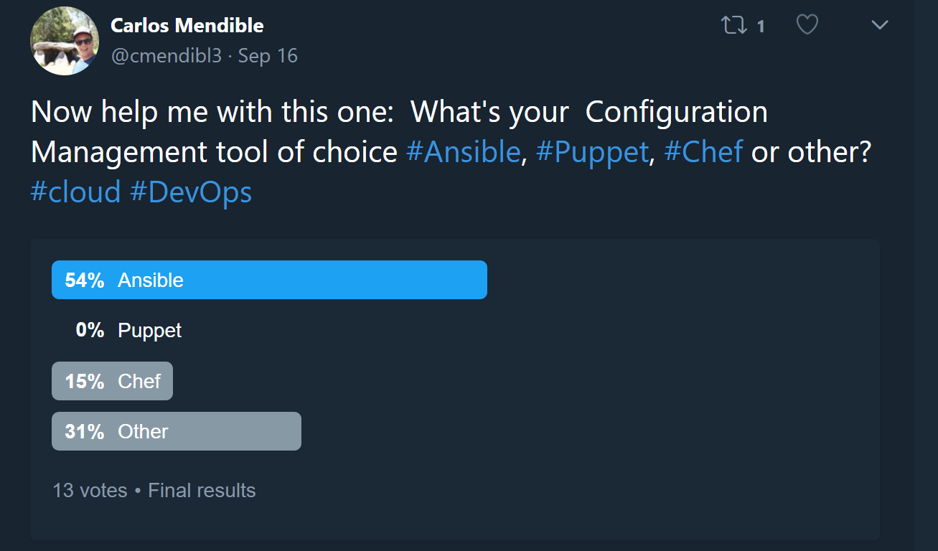
What does my network have to say?

Slide 9
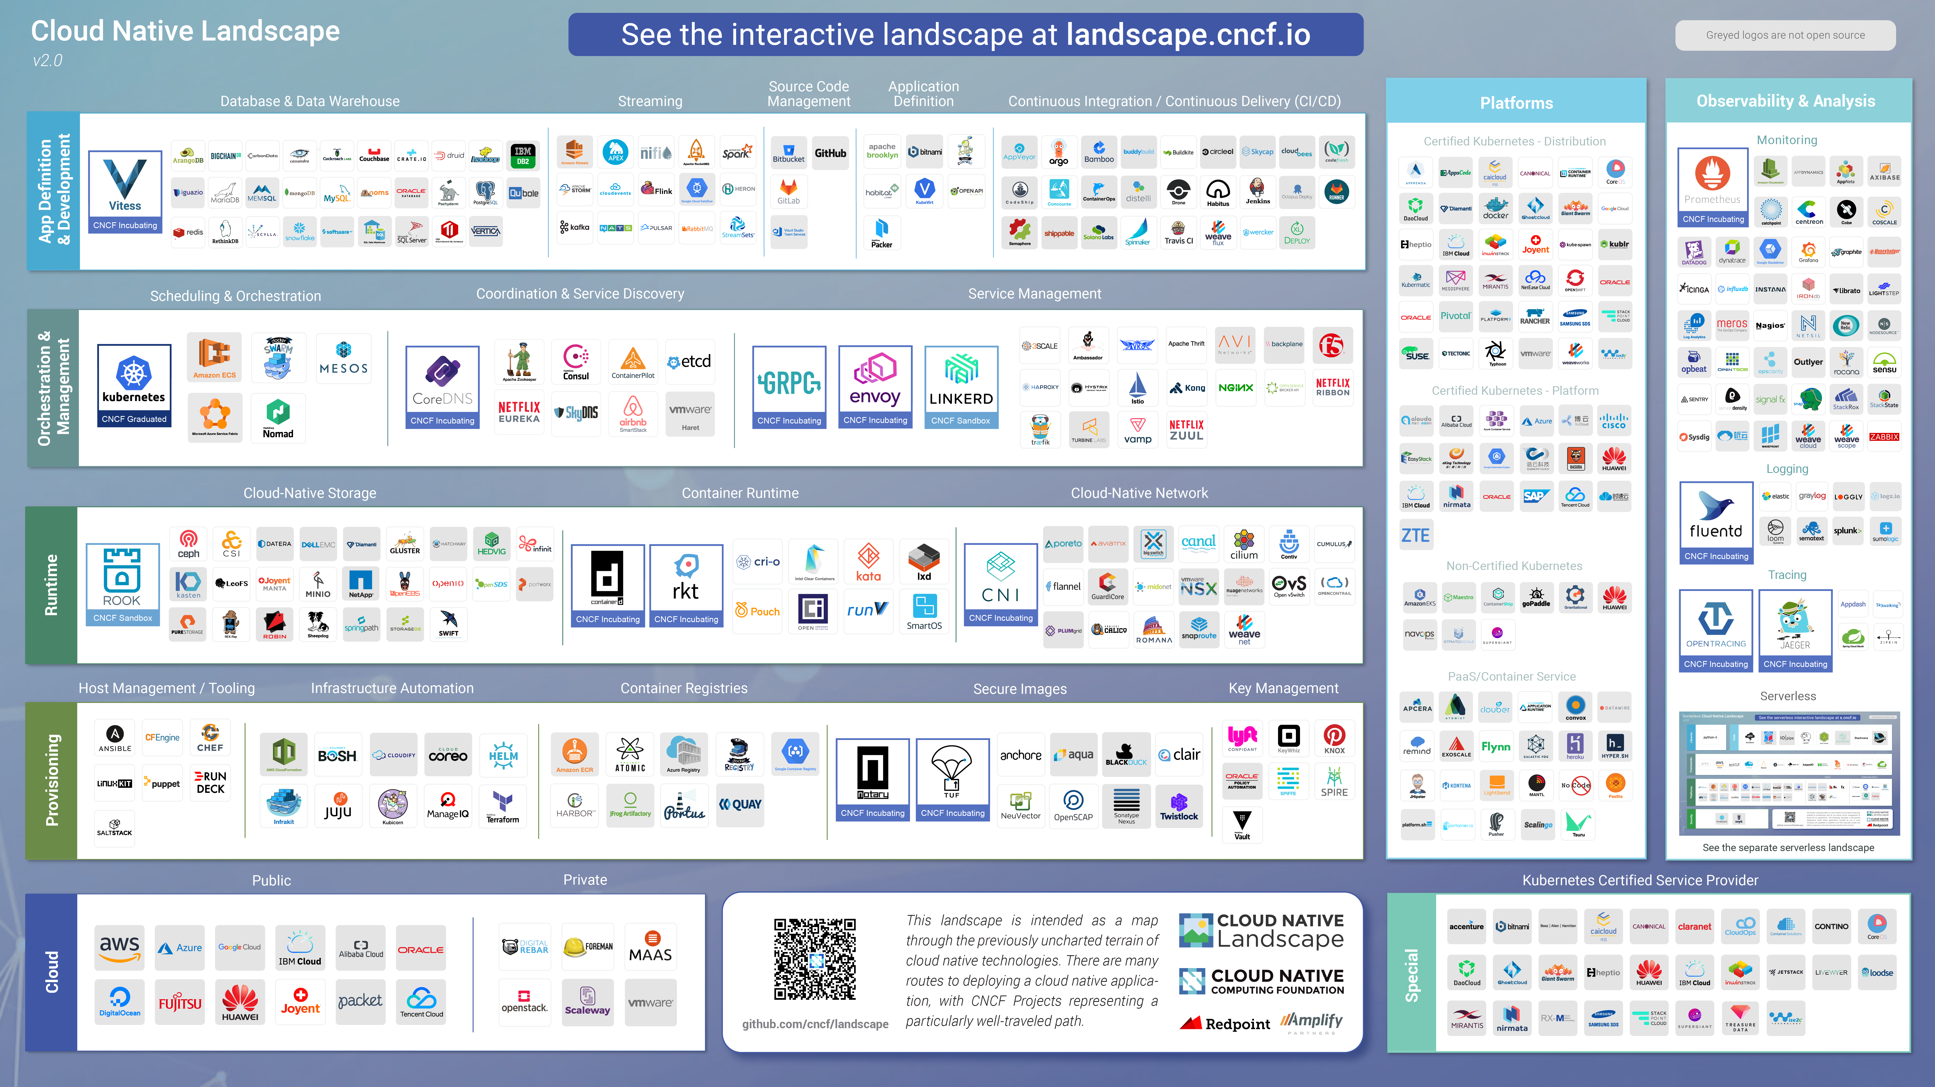

Slide 10


Slide 11
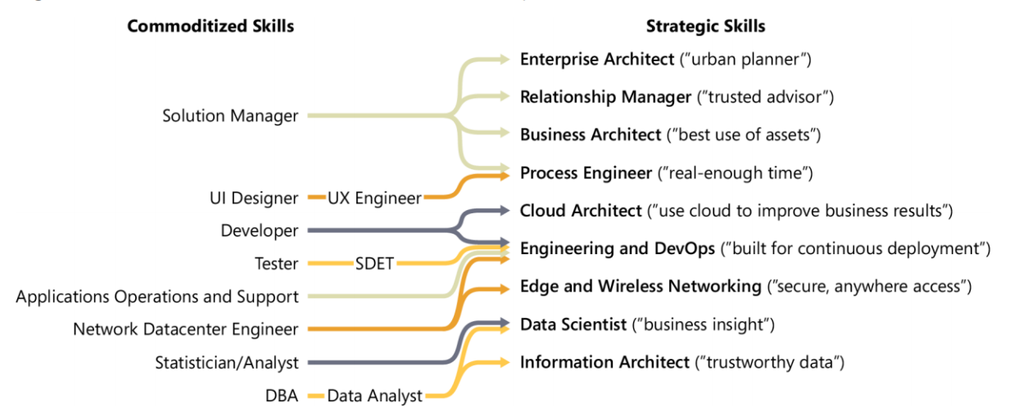
Cloud: The evolution of roles
Enterprise Cloud Strategy. Barry Brigs

Slide 12
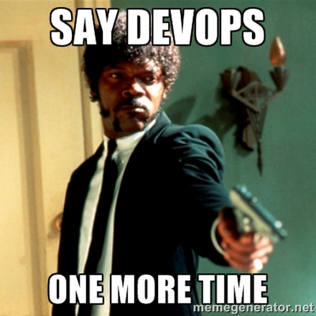
Our “new” role as Developers
We are responsible for:
Turning new requirements into code
Unit testing
Deployment
Ongoing monitoring

Slide 13
Let’s see what’s all this about

Slide 14

We Code
public static IWebHostBuilder CreateWebHostBuilder(string[] args) =>
WebHost.CreateDefaultBuilder(args)
.UseStartup<Startup>()
.UseKestrel()
.Configure(app =>
{
app.Run(httpContext =>
{
var request = httpContext.Request;
var response = httpContext.Response;
// Echo the Headers
foreach (var header in request.Headers)
{
response.Headers.Add(header);
}
// Echo the body
return request.Body.CopyToAsync(response.Body);
});
});

Slide 15

We Test… Right?
[Fact]
public async Task Get_With_Custom_Header()
{
string headerName = "Custom-Header";
Client.DefaultRequestHeaders.Add(headerName, "echo");
var response = await Client.GetAsync("/");
response.EnsureSuccessStatusCode();
var responseStrong = await response.Content.ReadAsStringAsync();
Assert.Equal(string.Empty, responseStrong);
Assert.Equal("echo", response.Headers.GetValues(headerName).First());
}

Slide 16

We even Build and Test!
pool:
vmImage: 'Ubuntu-16.04’
variables:
buildConfiguration: 'Release’
dockerId: 'dotnetconf’
imageName: 'echoserver:$(Build.BuildId)'
steps:
- script: |
dotnet build --configuration $(buildConfiguration) ./src/echoserver.sln
- task: DotNetCoreCLI@2
inputs:
command: test
projects: '**/*tests/*.csproj’
arguments: '--configuration $(buildConfiguration) --collect "Code coverage“’
- script: |
cd src/echoserver
dotnet publish --configuration $(buildConfiguration) --output "$(Build.ArtifactStagingDirectory)\netcoreapp2.1"
- task: PublishBuildArtifacts@1

Slide 17
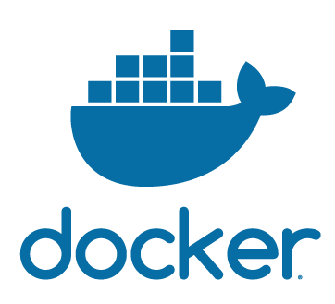
Some of us build Containers
FROM microsoft/dotnet AS builder
COPY . src
WORKDIR src
RUN dotnet restore
RUN dotnet publish -c release
FROM microsoft/dotnet
COPY --from=builder src/bin/release/netcoreapp2.1/publish app
WORKDIR app
ENV ASPNETCORE_URLS http://*:80
EXPOSE 80
ENTRYPOINT ["dotnet", "echoserver.dll"]

Slide 18
Some of us include Containers in CI/CD
- task: Docker@1
displayName: Login
inputs:
azureSubscriptionEndpoint: 'HexaAzureSubscription'
azureContainerRegistry: $(dockerId).azurecr.io
command: login
- script: |
cd src/echoserver
docker build -t $(dockerId).azurecr.io/$(imageName) .
docker push $(dockerId).azurecr.io/$(imageName)

Slide 19


Who does Infrastructure as code?
---
- name: Deploy an Azure Container Instance Group
hosts: localhost
gather_facts: no
tasks:
- name: Create Resource Group
azure_rm_resourcegroup:
location: "northeurope"
name: "netConf2018"
state: present
- name: Create the ACI Container Croup
azure_rm_containerinstance:
resource_group: netConf2018
name: netConf2018
os_type: linux
ip_address: public
ports:
- 80
containers:
- name: echoserver
image: docker.io/cmendibl3/echoserver:1.0
memory: 1.5
ports:
- 80
register: new_aci
- name: Show the ACI Public IP
debug:
msg: "{{ new_aci.ip_address }}"

Slide 20
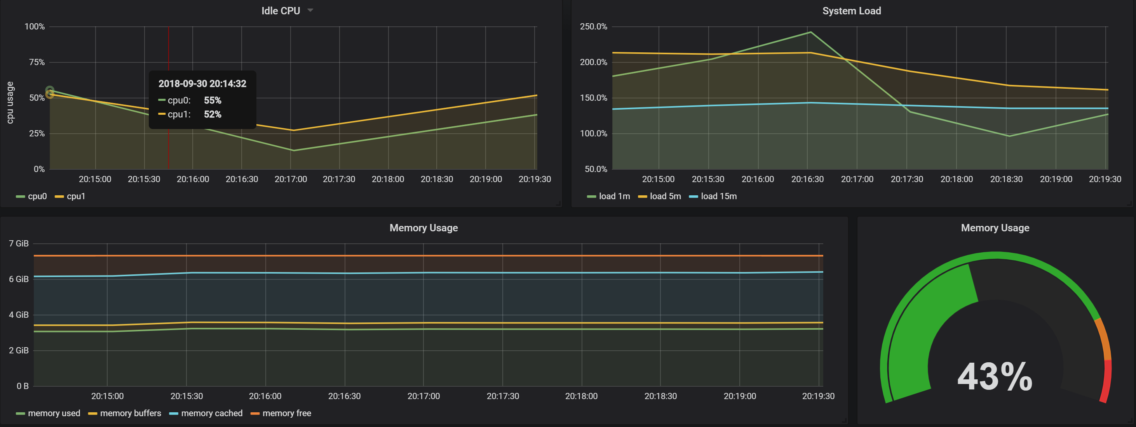



And after all what is monitoring?
helm init
helm repo add coreos https://s3-eu-west-1.amazonaws.com/coreos-charts/stable/
helm install coreos/prometheus-operator --name prometheus-operator --namespace monitoring --set rbacEnable=false
helm install coreos/kube-prometheus --name kube-prometheus --set global.rbacEnable=false --namespace monitoring
kubectl --namespace monitoring port-forward $(kubectl get pod --namespace monitoring -l app=kube-prometheus-grafana -o template --template "{{(index .items 0).metadata.name}}") 3000:3000

Slide 21


Slide 22
Thank you!!! @cmendibl3

